Slide 1
Unsupervised Machine Learning
Atul Kahate
https://www.linkedin.com/in/atulkahate/

Slide 2
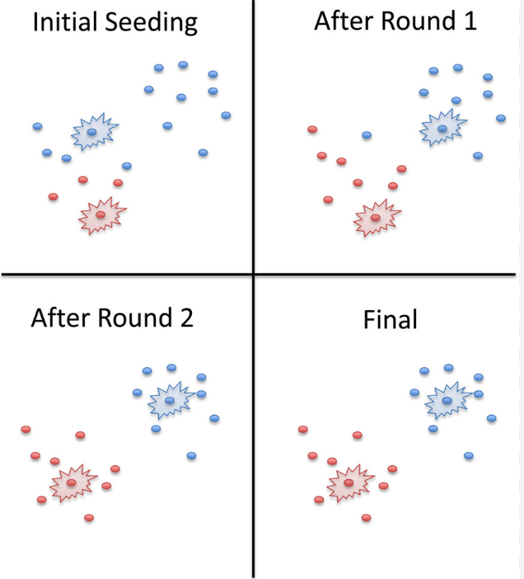
K-Means Clustering
An unsupervised machine learning algorithm used to group similar data points into clusters based on distance
Goal
  Divide data into K groups (clusters)
  Points in the same cluster are similar
  Points in different clusters are dissimilar
Working
  Choose K (number of clusters)
  Randomly place K centroids
  Assign each data point to the nearest centroid
  Recompute centroids (mean of points)
  Repeat steps 3–4 until centroids stop changing

Slide 3
K-Means Clustering and Elbow Method
Step | Action | Our example
1 | Choose K | Let K = 2
2 | Pick 2 random centers | Center 1 = 35, Center 2 = 75
3 | Assign points to nearest centers | 35, 38, 40 -> Cluster 1 75, 78, 82 -> Cluster 2
4 | Recalculate centers | New Center 1 ≈ 38 New Center 2 ≈ 78
5 | Repeat and stop when clusters do not change | NA
Final result:
Low scores cluster and
High scores cluster
K-Means = Grouping similar data points together
K = Number of groups (clusters)
Means = Center of each group
Used when no labels are available, i.e. Unsupervised learning
Student data: Make 2 clusters
Student | Marks
A | 35
B | 38
C | 40
D | 75
E | 78
F | 82
K = 1, Center = 58
K = 2 (2 groups)
K = 3 (3 groups)
K = 4 (4 groups)
Marks | Far from center?
35 | very far
38 | far
40 | far
75 | far
78 | far
82 | far
Cluster | Marks
1 | 35, 38, 40 (Center = 38)
2 | 75, 78, 82 (Center = 78)
Cluster | Marks
1 | 35, 38 (Center = 36.5)
2 | 40 (Center = 40)
3 | 75, 78, 82 (Center = 78)
Cluster | Marks
1 | 35 (Center = 36.5)
2 | 38, 40 (Center = 39)
3 | 75, 78 (Center = 76.5)
4 | 82 (Center = 82)
Cluster | Are points close to center?
Low marks | YES
High marks | YES
K | Improvement
1 → 2 | BIG improvement
2 → 3 | small improvement
3 → 4 | very tiny improvement
Only a small improvement – Error drops a little
Very bad grouping
Very high error
No real improvement
Huge improvement – Error drops a lot
The point where improvement suddenly slows down = Elbow

Slide 4
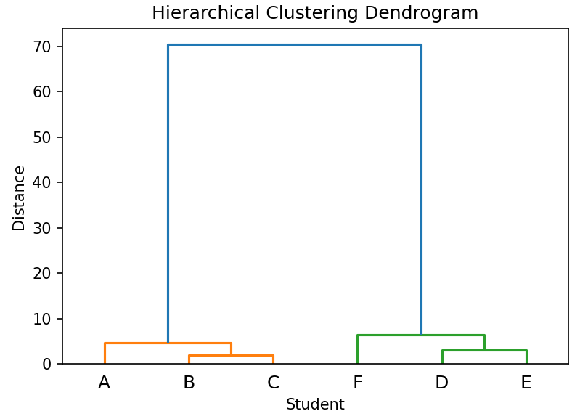
Hierarchical Clustering
Step | Action | Our example | Result
1 | Everyone is alone | 35 38 40 75 78 82
2 | Find closest pair | 38 and 40 -> very close 75 and 78 -> very close | Merge them (38,40) (75,78) 35 82
3 | Next closest | 35 is closer to (38,40) 82 is closer to (75,78) | Merge again (35,38,40) (75,78,82)
4 | Final merge | Now only 2 clusters are left, so merge them | Final merge (35,38,40,75,78,82)
Start with everyone separate and keep merging the closest ones, step by step
Student | Marks
A | 35
B | 38
C | 40
D | 75
E | 78
F | 82
Dendogram: A tree-like diagram that shows (a) Who merged with whom, (b) At what distance
How to choose number of clusters from Dendogram?
Make a cut before the final large merge
For our data, if we do this cut
(35,38,40) | (75,78,82)
We will get 2 clusters (Low scores and High scores)

Slide 5
Gaussian Mixture Models (GMM) and Soft Clustering
Hard clustering (e.g. K-Means): Each data point belongs to only one cluster
Example
Student A -> Cluster 1 (100%)
Student B -> Cluster 2 (100%)
Gaussian Mixture Model (GMM)
GMM assumes that the data is generated from a mixture of multiple Gaussian (Normal) distributions
Each cluster = one Gaussian (which has its own mean, standard deviation, and importance)
Consider student marks: 35, 38, 40, 75, 78, 82
Instead of forcing
Low scores -> Cluster 1
High scores -> Cluster 2
GMM says that some marks may come from two overlapping clusters
Example: For student with marks 40
Probability of Low-score cluster = 85%
Probability of High-score cluster = 15%
This is soft clustering
Soft clustering: A data point can belong to multiple clusters with probabilities
Example
Student A -> Cluster 1 (70%), Cluster 2 (30%)
Useful when data overlaps
Why K-Means is not enough?
K-Means assumes
All clusters have same size
Each data point belongs to exactly one cluster
But real data often
Overlaps
Has different shapes and spreads
=> Gaussian Mixture Models (GMM)

Slide 6
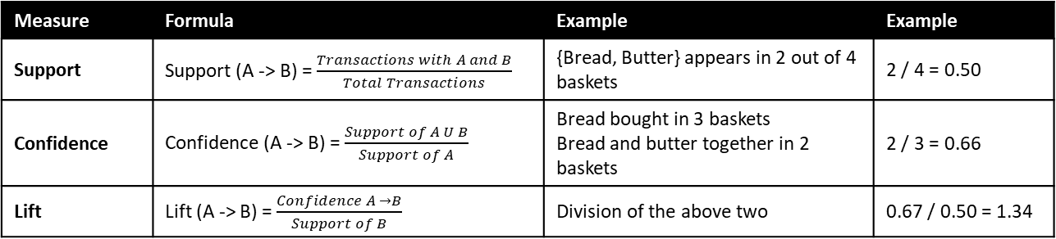
Association Rule Mining
Finds patterns of data that occur together in large datasets – Market Basket Analysis
Transaction | Items
T1 | Bread, Milk
T2 | Bread, Butter
T3 | Bread, Milk, Butter
T4 | Milk
“Customers who buy bread often also buy butter”
Term | Meaning
Item | A single product (Milk)
Transaction | A set of items together (Bread, Butter)
Itemset | One or more items (Bread, Milk)
Measure | Formula | Example | Example
Support | Support (A -> B) = $\frac{Transactions with A and B}{Total Transactions}$ | {Bread, Butter} appears in 2 out of 4 baskets | 2 / 4 = 0.50
Confidence | Confidence (A -> B) = $\frac{Support of A U B}{Support of A}$ | Bread bought in 3 baskets Bread and butter together in 2 baskets | 2 / 3 = 0.66
Lift | Lift (A -> B) = $\frac{Confidence A →B}{Support of B}$ | Division of the above two | 0.67 / 0.50 = 1.34
Association Rule: A -> B (If A is bought, B also will be bought)
Bread → Butter
Key measures
Support: How often items appear together
Confidence: How often B is bought when A is bought
Lift: How much better than chance the rule is
Lift Value | Interpretation
> 1 | Positive association
= 1 | No association
< 1 | Negative association
Bread buyers are 1.34 times more likely to buy butter than a random customer

Slide 7
Apriori Algorithm
A data mining algorithm used to find frequent itemsets and association rules in transactional data
Classic use: Market Basket Analysis (People who bought this book also bought this)
Inputs: Transaction dataset (each row = items bought together)
Outputs: Frequent itemsets, Association rules, e.g. A -> B
Core idea: If an itemset is frequent, all its subsets must also be frequent
  If {milk, bread} is frequent
  then {milk} and {bread} must be frequent
This rule helps prune (remove) useless combinations early

Slide 8


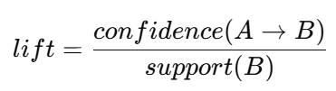
Apriori Algorithm
Step 1: Generate C1 (Candidate 1-itsemsets)
All possible single items we found in the data
Final frequent itemsets
L1: {Bread, Milk, Butter}
L2: {(Bread, Milk), (Bread, Butter)}
Used in association rule mining to find frequent itemsets from transactional data
Basic idea: If an itemset is frequent, all its subsets must also be frequent
Item | Items | Support
Bread | 3 | 3/4 = 0.75
Milk | 3 | 3/4 = 0.75
Butter | 2 | 2/4 = 0.50
Step 5: Generate Association Rules
Association Rules are generated from all frequent itemsets of size >= 2
From L2: {(Bread, Milk), (Bread, Butter)}
One example: (Bread, Milk)
Support (Bread and Milk) = 2/4 = 0.5
Support (Bread) = 3/4 = 0.75
Support (Milk) = 3/4 = 0.75
Possible rules:
Bread -> Milk
  Confidence = 0.5/0.75 = 0.67
  67% of the time when Bread is bought, Milk is bought, too
Milk -> Bread
  Confidence = 0.5/0.75 = 0.67
  67% of the time when Milk is bought, Bread is bought, too
Repeat for (Bread, Butter)
Lift(Bread → Milk) = 0.67 / 0.75 ≈ 0.89
(< 1 → weak/negative association)
Transaction | Items
T1 | Bread, Milk
T2 | Bread, Butter
T3 | Bread, Milk, Butter
T4 | Milk
Step 2: Generate L1 (Frequent 1-itsemsets)
Only those items whose support >= min support
Obtain L1 by filtering C1
Suppose minimum support = 50%
All the above satisfy this, so
L1 = {Bread, Milk, Butter}
Step 3: Generate C2 (Candidate 2-itsemsets)
Key concepts
Support: How often an itemset appears
Confidence: How reliable a rule is
Lift: How strong an association is
Item | Items | Support
Bread, Milk | 2 | 2/4 = 0.50
Bread, Butter | 2 | 2/4 = 0.50
Milk, Butter | 1 | 1/4 = 0.25
Step 4: Generate L2 (Frequent 2-itsemsets)
L2 = {(Bread, Milk), (Bread, Butter)}
Note: (Milk, Butter} is removed
No frequent 3-itemsets: Stop

Slide 9
FP-Growth Algorithm
Step 1: Count item frequency (1st scan)
Step 3: Conceptual FP-Tree
Step 4: Mining Frequent Patterns
Item | Count
Bread | 4
Milk | 4
Cola | 3
Eggs | 3
NULL
├─ Bread(4)
│ └─ Milk(3)
│ ├─ Cola(1)
│ └─ Eggs(1)
│ └─ Cola(1)
│ └─ Eggs(1)
└─ Milk(1)
└─ Cola(1)
└─ Eggs(1)
Frequent Pattern Growth Algorithm
Association rule mining technique that finds frequent itemsets without generating candidate itemsets (unlike Apriori)
Advantage: Much faster on larger datasets
Patterns with Cola
Conditional pattern base
Bread -> Milk -> Cola
Bread -> Cola
Milk -> Cola
Frequent itemsets
{Cola}
{Bread, Cola}
{Milk, Cola}
Two phases
Phase 1: Build FP-Tree
Compress transactions into a tree
Preserve frequency information
Phase 2: Mine frequent patterns
Extract frequent itemsets from the tree
No candidate generation
Step 2: Sort items in each transaction (Descending order)
Transaction | Sorted Items
T1 | Bread, Milk
T2 | Bread, Cola, Eggs
T3 | Milk, Cola, Eggs
T4 | Bread, Milk, Cola
T5 | Bread, Milk, Eggs
Patterns with Eggs
Conditional pattern base
Bread -> Milk -> Eggs
Bread -> Eggs
Milk -> Eggs
Frequent itemsets
{Eggs}
{Bread, Eggs}
{Milk, Eggs}
Step 6: Final Frequent Itemsets
{Bread}
{Milk}
{Cola}
{Eggs}
{Bread, Milk}
{Bread, Cola}
{Milk, Cola}
{Bread, Eggs}
{Milk, Eggs}
Sample dataset, Min Support = 3
TID | Items
T1 | Bread, Milk
T2 | Bread, Cola, Eggs
T3 | Milk, Cola, Eggs
T4 | Bread, Milk, Cola
T5 | Bread, Milk, Eggs

Slide 10
ELCAT Algorithm
Step 1: Frequent 1-itemsets (L1)
Step 2: Frequent 2-itemsets
(TID intersection)
Equivalent Class Transformation
Finds frequent itemsets by intersecting transaction ID lists (TID-lists)
All items satisfy min support ≥ 3
L1 = {Bread}, {Milk}, {Cola}, {Eggs}
{Bread, Milk}
Bread → {T1, T2, T4, T5}
Milk → {T1, T3, T4, T5}
----------------------------------
Intersection = {T1, T4, T5}
Support = 3 (Ok)
{Bread, Cola}
{T1, T2, T4, T5} ∩ {T2, T3, T4} = {T2, T4}
Support = 2 (Not ok)
{Milk, Cola}
{T1, T3, T4, T5} ∩ {T2, T3, T4} = {T3, T4}
Support = 2 (Not ok)
{Bread, Eggs}
{T1, T2, T4, T5} ∩ {T2, T3, T5} = {T2, T5}
Support = 2 (Not ok)
{Milk, Eggs}
{T1, T3, T4, T5} ∩ {T2, T3, T5} = {T3, T5}
Support = 2
{Cola, Eggs}
{T2, T3, T4} ∩ {T2, T3, T5} = {T2, T3}
Support = 2 (Not ok)
Sample dataset, Min Support = 3
TID | Items
T1 | Bread, Milk
T2 | Bread, Cola, Eggs
T3 | Milk, Cola, Eggs
T4 | Bread, Milk, Cola
T5 | Bread, Milk, Eggs
Step 3: Frequent itemsets found
L1
{Bread} (4)
{Milk} (4)
{Cola} (4)
{Eggs} (4)
L2
{Bread, Milk} (3)
Rearrange to have Item -> TID list
Item | TID-list | Support
Bread | {T1, T2, T4, T5} | 4
Milk | {T1, T3, T4, T5} | 4
Cola | {T2, T3, T4} | 3
Eggs | {T2, T3, T5} | 3
Key point: The only database scan needed

Slide 11
Evaluation and Similarity
Metric | Used at | Measures | Example role
Cosine Similarity | Before / during clustering | Point similarity | Compare customers
Silhouette Score | After clustering | Point-level cluster quality | Does a point belong?
Davies–Bouldin | After clustering | Cluster-level quality | Are clusters good?
Example: Run K-Means (k = 2) on customer data
Features: Annual spending, Visit frequency
Labels: Unknown (Unsupervised learning)
After clustering
Cluster A: Regular customers
Cluster B: Occasional customers
Objectives
Measure similarity between points
Judge how good clustering is
Cosine Similarity
Customer vectors
Customer 1 = (High spending, High visits) -> (8, 7)
Customer 2 = (High spending, Medium visits) => (7, 6)
Cosine similarity = High
Both point in almost the same direction
Even if spending amounts differs, their behaviour pattern is similar
Summary: Helps decide which points are similar when no labels exist
Silhouette Score
One customer in Cluster A
a = Average distance to other customers in Cluster A
b = Average distance to customers in nearest another cluster (B)
If
a is small (close to own cluster)
b is large (far from another cluster)
Silhouette score ≈ 1
If score ≈ 1 -> Correct cluster assignment
If score ≈ 0 -> Clusters overlap
If score < 0 -> Wrong cluster assignment
Davies-Bouldin Index
Low DBI value
Cluster A: customers tightly grouped
Cluster B: customers tightly grouped
Distance between cluster centers is large
High DBI value (Bad Clustering)
Clusters are spread out internally
Cluster centers are close

Slide 12
Techniques Compared
Technique | Core idea (intuition) | Data type it likes | Output | Needs k / params? | Scales well? | When to use (simple rule)
k-Means Clustering | Group points by closeness to centroids | Numeric only | Clusters | Yes (k) | Very well | Large numeric data, clear clusters
Hierarchical Clustering | Build clusters step-by-step (tree) | Numeric / distance-based | Dendrogram | No k upfront | Poor | Small data, need structure
Association Rule Mining | Find “if–then” patterns | Categorical / transactions | Rules (X → Y) | Support, confidence | Medium | Market-basket analysis

Slide 13
When to Use What
# | Explicit problem | Use | Why this method fits
1 | Group customers by age, income, spending score | k-Means | Numeric data + want clear groups
2 | Find which products are bought together (bread → butter) | Association Rules | Looking for co-occurrence patterns
3 | Cluster emails by writing style (not spam/ham) | Hierarchical | Small dataset, want to see structure
4 | Segment mobile users by usage time, data, calls | k-Means | Large numeric dataset
5 | Discover courses students take together | Association Rules | “If enrolled in X, also enroll in Y”
6 | Group news articles by topic (small corpus) | Hierarchical | Need visual cluster tree
7 | Compress an image by reducing colors | k-Means | Pixels cluster around colors
8 | Find shopping patterns in supermarket bills | Association Rules | Transaction-based data
9 | Explore genetic similarity between samples | Hierarchical | Dendrogram shows closeness
10 | Segment website visitors by behavior metrics | k-Means | Scalable numeric clustering

